Slide 1
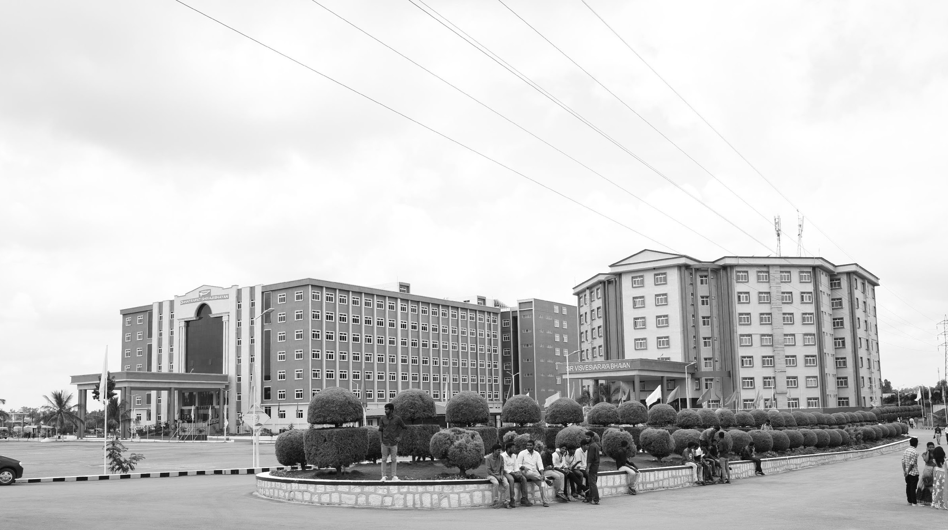

MULTI OBJECT TRACKING ON LOW COST EMBEDDED PLATFORMS
AY 2021-25
GITAM UNIVERSITY
Major Project
Project ID: A8
A University should be a place of light, of liberty, and of learning.
Department of Electrical Electronics and Communication Engineering
Project Team:
109 Domma Anil Kumar
.402 M.V.Rathnakar Reddy
435 N.Badrinath Reddy
Project Mentor:
Dr.Venkata Kranthi
www.gitamedu.com

Slide 2




Project Group – Details
Photo
Track
Roll No
Name
EECE AI/ML
BU21EECE0100109
DOMMA ANIL KUMAR
Photo
EECE AI/ML
BU21EECE0100402
M.V.RATHNAKAR REDDY
Photo
EECE AI/ML
BU21EECE0100435
N.BADRINATH REDDY

Slide 3
Objective and Goals
Objective
Design and implement an MOT system for an autonomous vehicle using Raspberry Pi. The system shall be able to determine with accuracy the location of multiple objects in real time, such as pedestrians, vehicles, or other obstacles, to guarantee safety and informed decision-making when navigating any setting that concerns dynamic environments of driving
Goals
Main Goals
DATA COLLECTION
DETECTION
TRACKING
DATA ASSOCIATION

Slide 4
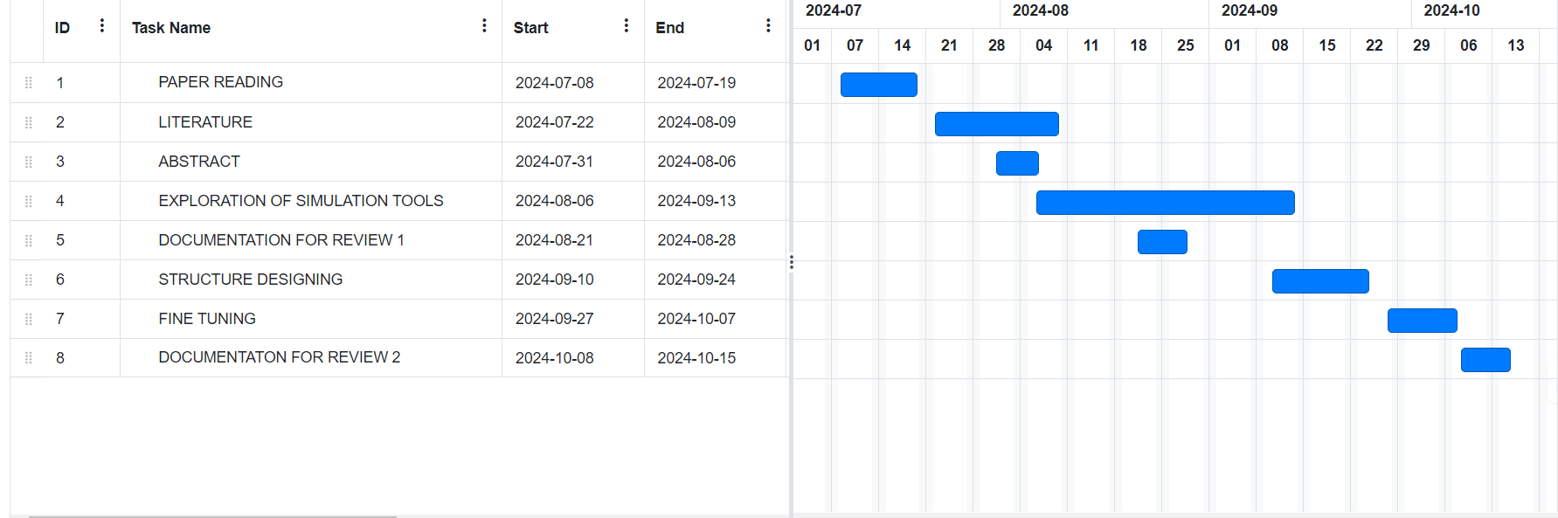
Project Plan

Slide 5
Literature Survey
S.No. | TITLE | AUTHOR | YEAR OF PUBLISHING | PARAMETERS MENTIONED
1 | EchoTrack: Auditory Referring Multi-Object Tracking for Autonomous Driving | Jiacheng Lin, Jiajun Chen | 2019 | Scene Understanding: Understands auditory and visual aspects. Multi-Object Tracking: Tracks multiple objects using audio-visual cues. Bi-FCFM: Aligns and fuses audio-visual features. ACTL: Preserves features over long-range tracking.
2 | Deep Learning-Based Robust Multi-Object Tracking via Fusion of mmWave Radar and Camera Sensors | Lei Cheng, Siyang Cao | 2020 | Deep Learning for MOT: Utilizes deep learning to enhance multi-object tracking. Sensor Fusion: Combines mm Wave radar and camera data for improved accuracy. Bi-LSTM: Incorporates long-term temporal information for better motion prediction. Robustness: Ensures reliable tracking in low-visibility and occlusion scenarios.

Slide 6
3 | Real Time Object Tracking for Intelligent Vehicle | Deepak Kumar Dewangan, Satya Prakash Sahu | 2020 | Tracking Method: Techniques used for object tracking. Performance Metric: Measures of tracking accuracy and speed. Environmental Conditions: Variability in conditions during experiments.
4 | An Overview of Multi-Object Estimation via Labeled Random Finite Set | Ba-Ngu Vo, Ba-Tuong Vo, Tran Thien Dat Nguyen, Changbeom Shim | 2018 | Tracking Method: Labeled Random Finite Set (LRFS) framework. Performance Metric: Multi-object trajectory estimation accuracy. Environmental Conditions: Variability in object counts and states over time. 4o mini

Slide 7
Analysis - SWOT
Strengths
Weaknesses
1.Challenges With Non Linear Motion
2.Low confidence Detections
3.Limited Generalizability
1. importance in Autonomous Driving
2. Advancements in Pedestrian Tracking
3. Focus on Complex Environments
Threats
1. Rapid Technological Changes
2. Competition from Emerging Technologies
Opportunities
1.Improvement of Algorithms
2.Incorporation of New Techniques
3.Growing need for Autonomous Vehicles

Slide 8
Analysis – 4W1H
Why: Vehicle tracking in traffic environments is challenging due to higher speeds, nonlinear motion, frequent occlusions, and complex backgrounds. Improving MOT in these scenarios is crucial for enhancing the safety and reliability of autonomous systems and traffic management solutions.
What: The research focuses on Multi-Object Tracking (MOT), specifically on detecting and tracking vehicles in complex traffic scenarios. This involves identifying and following multiple vehicles in videos, which is essential for applications such as autonomous driving and traffic monitoring.
Where: The research is particularly relevant in complex traffic scenarios, including urban environments, highways, and intersections where multiple vehicles interact dynamically. These environments present significant challenges for existing MOT algorithms.
When: This issue arises primarily in real-time or near-real-time applications, such as during autonomous vehicle operation, traffic surveillance, and monitoring systems, where accurate and reliable vehicle tracking is essential for decision-making
How: The research proposes refining MOT algorithms to better handle the nonlinear motion of vehicles and improve detection confidence in cluttered and dynamic environments. This may involve integrating advanced techniques like deep learning, sensor fusion, and novel tracking strategies to enhance performance in real-world scenarios
Refined Objective: To develop and evaluate advanced Multi-Object Tracking (MOT) algorithms capable of accurately tracking vehicles in complex traffic scenarios, addressing challenges related to nonlinear motion, high speeds, occlusions, and cluttered backgrounds, thereby improving the safety and effectiveness of autonomous driving and traffic monitoring systems

Slide 9

OUTPUT

Slide 10
Contribution
Team Progress and Movement
Completed the Abstract and Articles and prearation hardware materials.
Going through the Implementation of the Multi Object Detection and object Tracking.
Individual Contribution
Key contributions: DOMMA ANIL KUMAR
Implementing the Software Part of the Multi Object Detection and Tracking.
Key contributions: M.V. RATHNAKAR
Studying the Articles and explaining the New Outcomes.
Key contributions: N. BADRINATH REDDY
Implementing the Hardware Part Of the Multi Object Detection and Tracking.

Slide 11
Conclusion & Future Work
Summary and Conclusion
"So far, we have analyzed object detection and acquired knowledge of the hardware components required for this project."
Future Work
The project's subsequent stages will then concentrate more on the Raspberry Pi's deeper hardware integration and improvements. To continue the software work where we are stuck and increase the effectiveness of object identification and tracking, future research would look into hardware like the Rasberypi.

Slide 12

THANK YOU

